Slide 1

Data and Time Revision
Name
Class
Teacher
Semester 2
Term 3
1

Slide 2
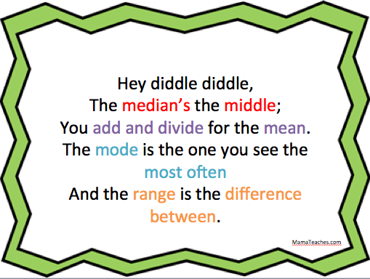

Slide 3
Statistics Revision
Categorical data: Described using words (Eg type of pet)
Discrete Numerical data: Expressed as whole numbers (Eg number of pets)
Continuous data: Ordered numbers, includes decimals (Eg height)
Biased data is when the data is unfair because of particular reason.
In a census (or population survey), everyone in a population is surveyed.
In a sample, a section of the population is surveyed.
A census is more accurate but samples are quicker and cheaper.
Mean is the average. Add all the scores and divide by how many there are.
Median is the middle value of ordered data. If there are two middle values then the average of them is taken, by adding them together and dividing by 2.
Mode is the most common vale. There may be several modes or no mode.
Range is the difference between the largest and smallest values. Maximum – Minimum
Outliers are extreme values. They may be a mistake and we should remove them
The mean and range are significantly affected by outliers.
The median and mode are not significantly affected by outliers.

Slide 4
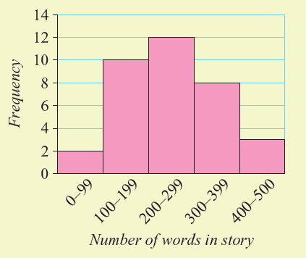
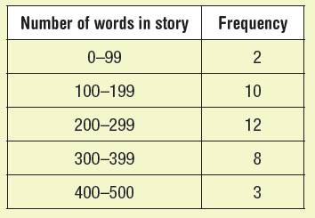
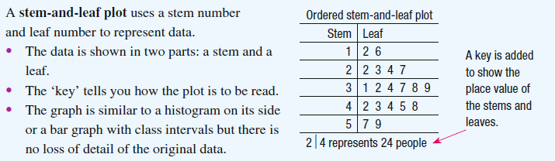
Histograms & Stem and Leaf Plots

Slide 5
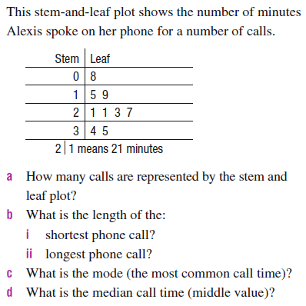
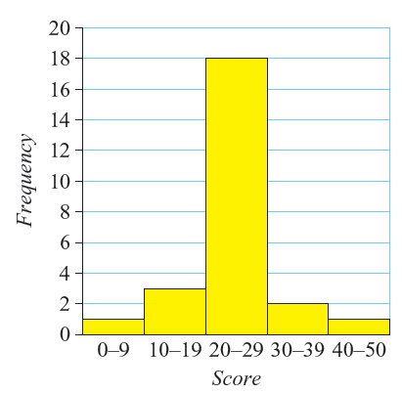
Now try these
This histogram represents how long some adults took to run 100m .
Seconds taken to run 100m
What type of data is this?
Is this a sample or a census? Why?
How many people did the run?
What is the range of the times?
Are there any potential outliers?
e) What is the mean call time?

Slide 6
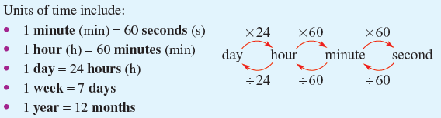
Time
24hr time
1am 0000hrs
1am 0100hrs
2am 0200hrs
2:25am 0225hrs
12pm 1200hrs
1pm 1300hrs
8pm 2000hrs
11:59pm 2359hrs
Elapsed Time
Step 1) Calculate number of hours without going over.
Eg There are 5 hours from 3:50am until 8:50am
Step 2) Add the minutes until the next hour and the minutes until the chosen time.
There are 10 minutes from 8:50am until 9:00am
+ There are 30 minutes from 9:00am until 9:30am
= There are 40 minutes from 8:50am until 9:30am
Step 3) Put them together
There are 5hrs and 40 mins from 3:50am until 9:30am
= 365 days
1 fortnight= 2 weeks

Slide 7
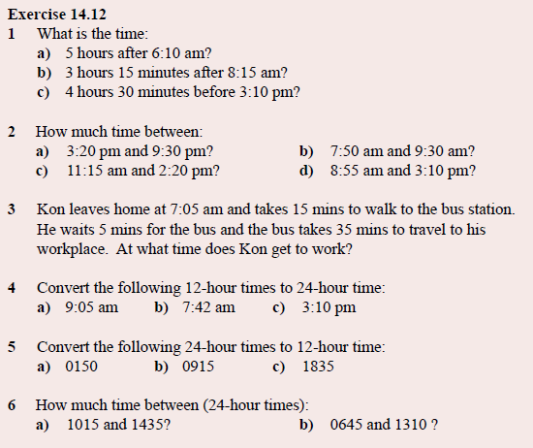

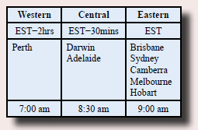

Try these
Conversions
120s= ______ mins
4mins = ________s
360mins = ____ hrs
5 days = _______ hrs
2 fortnights = ___wks
3 yrs = ________days

